Slide 1
Outline
What is RL? (Three steps in ML)
Policy Gradient
Actor-Critic
Reward Shaping
No Reward: Learning from Demonstration

Slide 2
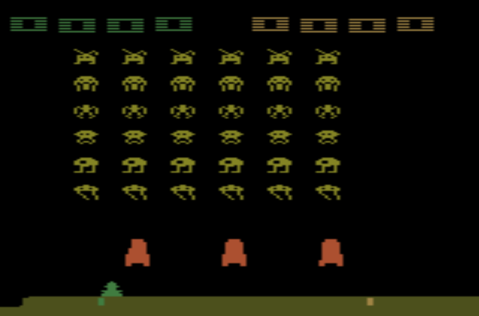
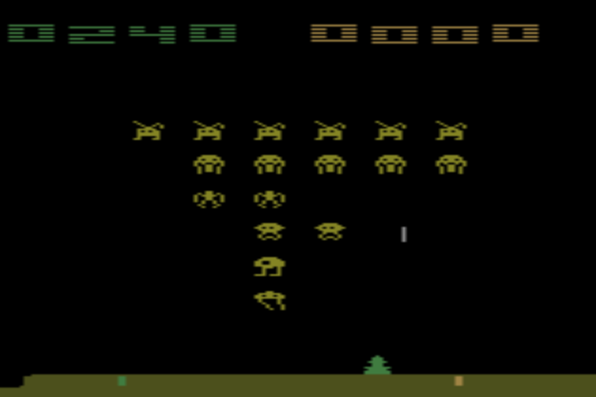
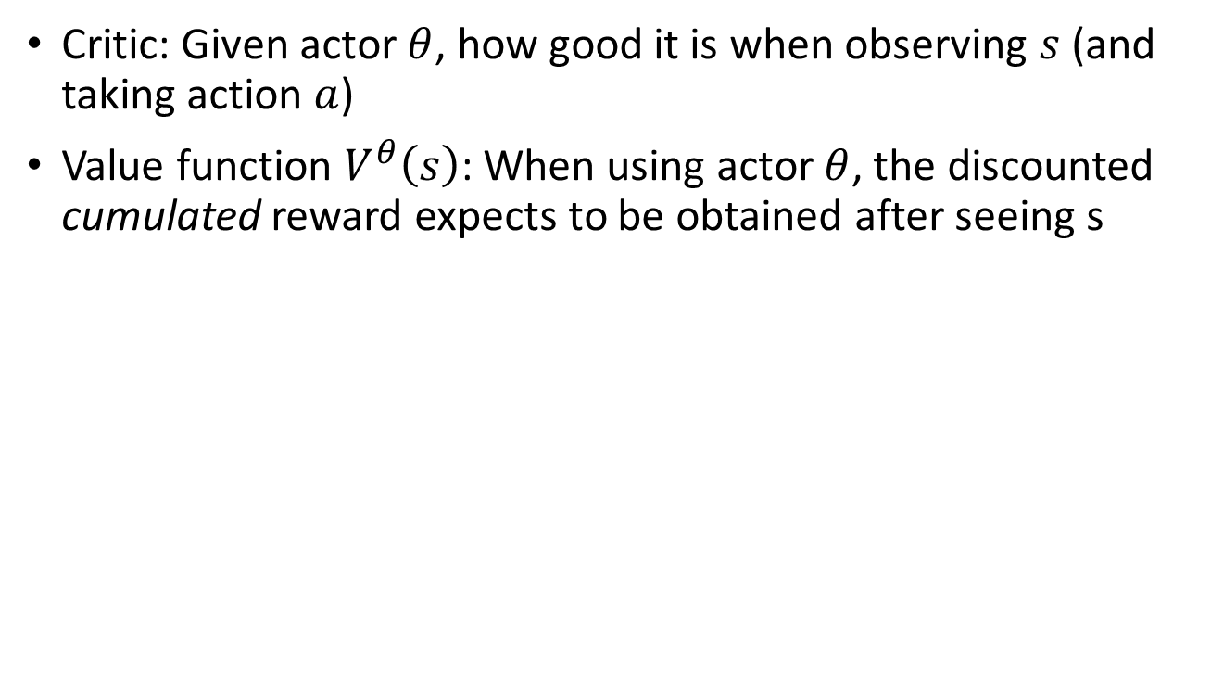
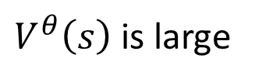
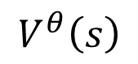
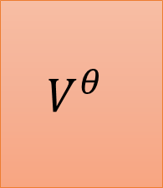
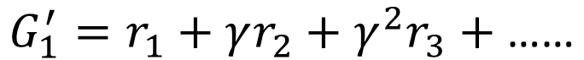
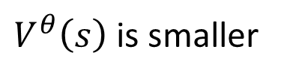
Critic
$$G_{1}^{′}=r_{1}+γr_{2}+γ^{2}r_{3}+\text{……}$$
Critic: Given actor $θ$, how good it is when observing $s$ (and taking action $a$)
Value function $V^{θ}\left(s\right)$: When using actor $θ$, the discounted cumulated reward expects to be obtained after seeing s
$$V^{θ}$$
$$V^{θ}\left(s\right)$$
s
scalar
$V^{θ}\left(s\right)$ is large
$V^{θ}\left(s\right)$ is smaller
The output values of a critic depend on the actor evaluated.
Notes:
(Lots of aliens to be killed, and the shields still exist)

Slide 3
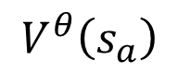
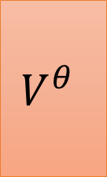
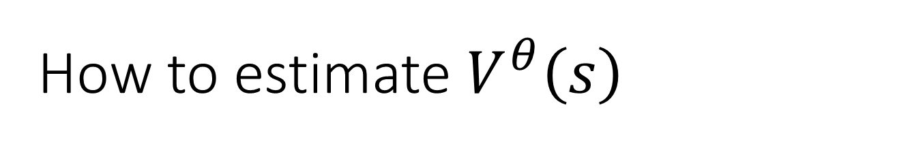
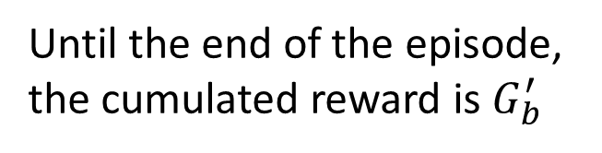
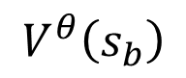
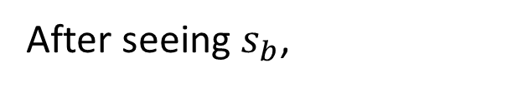
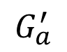
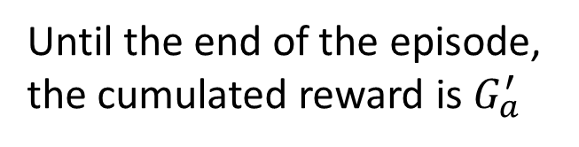
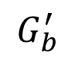
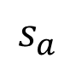
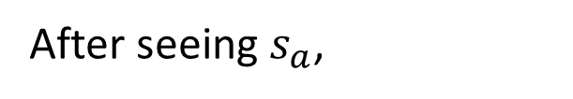

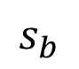
How to estimate $V^{θ}\left(s\right)$
Monte-Carlo (MC) based approach
The critic watches actor $θ$ to interact with the environment.
After seeing $s_{a}$,
$$V^{θ}$$
Until the end of the episode, the cumulated reward is $G_{a}^{′}$
$$s_{a}$$
$$V^{θ}\left(s_{a}\right)$$
$$G_{a}^{′}$$
After seeing $s_{b}$,
$$V^{θ}$$
Until the end of the episode, the cumulated reward is $G_{b}^{′}$
$$s_{b}$$
$$V^{θ}\left(s_{b}\right)$$
$$G_{b}^{′}$$
Notes:
The critic watches actor $θ$ to interact with environment.
The critic watches actor $θ$ to interact with environment.

Slide 4
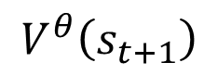
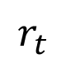
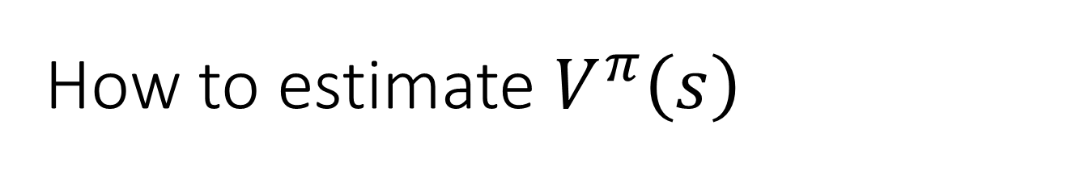
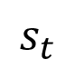
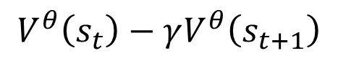
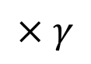

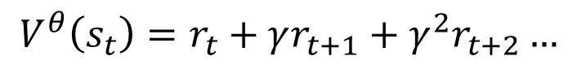
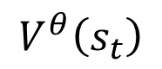
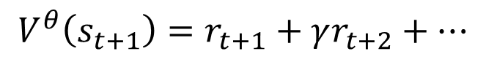
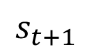
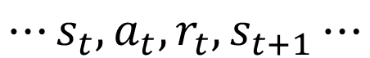

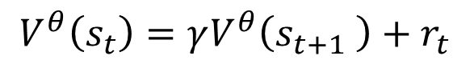
How to estimate $V^{π}\left(s\right)$
Temporal-difference (TD) approach
$$⋯s_{t},a_{t},r_{t},s_{t+1}⋯$$
(ignore the expectation here)
$$V^{θ}\left(s_{t}\right)=r_{t}+γr_{t+1}+γ^{2}r_{t+2}…$$
$$V^{θ}\left(s_{t+1}\right)=r_{t+1}+γr_{t+2}+…$$
$$V^{θ}$$
$$V^{θ}\left(s_{t}\right)=γV^{θ}\left(s_{t+1} \right)+r_{t}$$
$$s_{t}$$
$$V^{θ}\left(s_{t}\right)$$
-
$$V^{θ}\left(s_{t}\right)−γV^{θ}\left(s_{t+1}\right)$$
$$r_{t}$$
$$V^{θ}$$
$$×γ$$
$$s_{t+1}$$
$$V^{θ}\left(s_{t+1}\right)$$
Notes:
Some applications have very long episodes, so that delaying all learning until an episode's end is too slow.
===
The next most obvious advantage of TD methods over Monte Carlo methods is
that they are naturally implemented in an on-line, fully incremental fashion. With
Monte Carlo methods one must wait until the end of an episode, because only then
is the return known, whereas with TD methods one need wait only one time step.
Surprisingly often this turns out to be a critical consideration Other applications are continuing tasks and have no episodes at all.

Slide 5
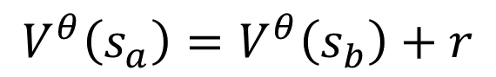
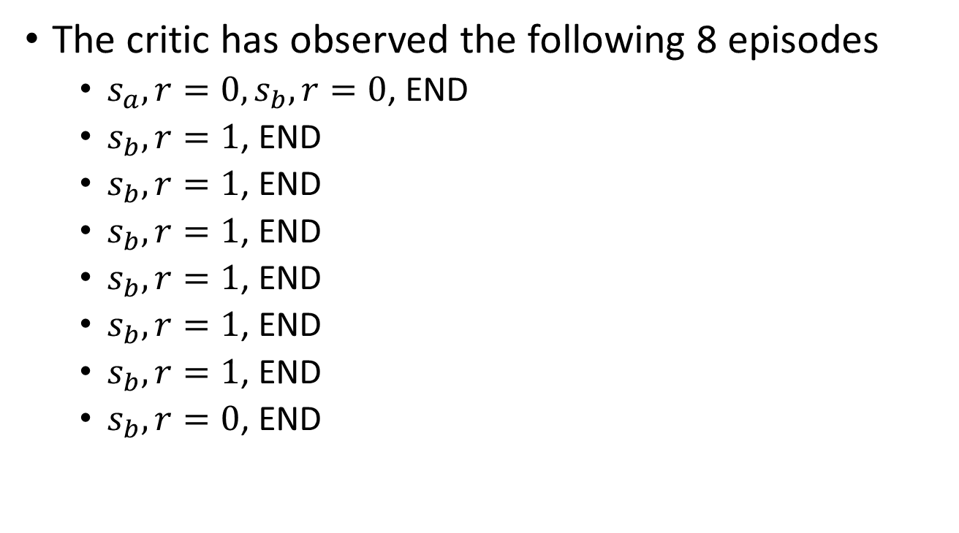
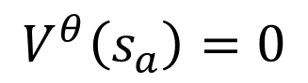
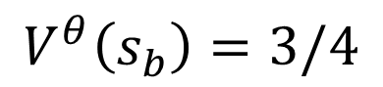
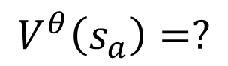
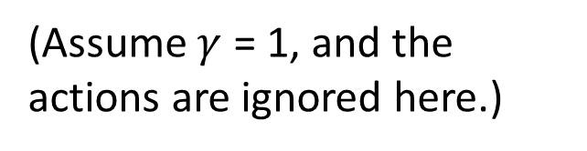
MC v.s. TD
[Sutton, v2, Example 6.4]
The critic has observed the following 8 episodes
$s_{a},r=0,s_{b},r=0$, END
$s_{b},r=1$, END
$s_{b},r=1$, END
$s_{b},r=1$, END
$s_{b},r=1$, END
$s_{b},r=1$, END
$s_{b},r=1$, END
$s_{b},r=0$, END
$$V^{θ}\left(s_{b}\right)=3/4$$
$$V^{θ}\left(s_{a}\right)=?$$
0?
3/4?
Monte-Carlo:
$$V^{θ}\left(s_{a}\right)=0$$
Temporal-difference:
$$V^{θ}\left(s_{a}\right)=V^{θ}\left(s_{b}\right)+r$$
(Assume $γ$ = 1, and the actions are ignored here.)
3/4
3/4
0

Slide 6
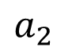
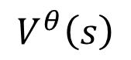
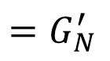
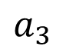
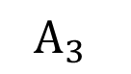
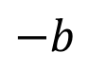
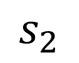
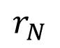
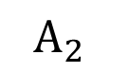
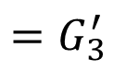
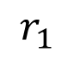
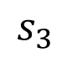


















Version 3.5
$$s_{1}$$
$$s_{2}$$
$$s_{3}$$
$$s_{N}$$
Training Data
$$a_{1}$$
$$a_{2}$$
$$a_{3}$$
……
$$a_{N}$$
$$\left\{s_{1},a_{1}\right\}$$
$$A_{1}$$
$$=G_{1}^{′}$$
$$−b$$
$$r_{1}$$
$$r_{2}$$
$$r_{3}$$
$$r_{N}$$
$$\left\{s_{2},a_{2}\right\}$$
$$A_{2}$$
$$=G_{2}^{′}$$
$$−b$$
$$\left\{s_{3},a_{3}\right\}$$
$$A_{3}$$
$$=G_{3}^{′}$$
$$−b$$
……
……
$$V^{θ}$$
$$V^{θ}\left(s\right)$$
$$\left\{s_{N},a_{N}\right\}$$
$$A_{N}$$
$$=G_{N}^{′}$$
$$−b$$
s
Notes:
Consider credit assignment

Slide 7




Version 3.5
$$s_{1}$$
$$s_{2}$$
$$s_{3}$$
$$s_{N}$$
Training Data
$$a_{1}$$
$$a_{2}$$
$$a_{3}$$
……
$$a_{N}$$
$$\left\{s_{1},a_{1}\right\}$$
$$A_{1}$$
$$=G_{1}^{′}$$
$$−V^{θ}\left(s_{1}\right)$$
$$r_{1}$$
$$r_{2}$$
$$r_{3}$$
$$r_{N}$$
$$\left\{s_{2},a_{2}\right\}$$
$$A_{2}$$
$$=G_{2}^{′}$$
$$−V^{θ}\left(s_{2}\right)$$
$$\left\{s_{3},a_{3}\right\}$$
$$A_{3}$$
$$=G_{3}^{′}$$
$$−V^{θ}\left(s_{3}\right)$$
……
……
$$V^{θ}$$
$$V^{θ}\left(s\right)$$
$$\left\{s_{N},a_{N}\right\}$$
$$A_{N}$$
$$=G_{N}^{′}$$
$$−V^{θ}\left(s_{N}\right)$$
s
Notes:
Consider credit assignment

Slide 8



















Version 3.5
$$\left\{s_{t},a_{t}\right\}$$
$$A_{t}$$
$$=G_{t}^{′}$$
$$−V^{θ}\left(s_{t}\right)$$
$$G=100$$
$$G=3$$
$$G=1$$
$$V^{θ}\left(s_{t}\right)$$
$$s_{t}$$
$$G=2$$
$$G=−10$$
(not necessary take $a_{t}$)
(You sample the actions based on a distribution)
$$A_{t}>0$$
$a_{t}$ is better than average.
$$a_{t}$$
$$G_{t}^{′}$$
$$A_{t}<0$$
$$s_{t}$$
$a_{t}$ is worse than average.
Just a sample
Notes:
Consider credit assignment

Slide 9










Version 4
$$r_{t}+V^{θ}\left(s_{t+1}\right)−V^{θ}\left(s_{t}\right)$$
$$\left\{s_{t},a_{t}\right\}$$
$$A_{t}$$
$$=G_{t}^{′}$$
$$−V^{θ}\left(s_{t}\right)$$
Advantage Actor-Critic
$$G=100$$
$$G=3$$
$$G=1$$
$$V^{θ}\left(s_{t}\right)$$
$$s_{t}$$
$$G=2$$
$$G=−10$$
(not necessary take $a_{t}$)
$$G=101$$
Obtain $r_{t}$
$$G=4$$
$$a_{t}$$
$$r_{t}$$
$$G=3$$
$$+V^{θ}\left(s_{t+1}\right)$$
$$s_{t}$$
$$s_{t+1}$$
$$G=1$$
$$G=−5$$
Notes:
Consider credit assignment

Slide 10

Tip of Actor-Critic
The parameters of actor and critic can be shared.
Network
left
Network
right
Actor
$$s$$
fire
Network
scalar
Critic

Slide 11

Outlook: Deep Q Network (DQN)
Video:
https://youtu.be/o_g9JUMw1Oc
https://youtu.be/2-zGCx4iv_k
https://arxiv.org/abs/1710.02298

Slide 12
Outline
What is RL? (Three steps in ML)
Policy Gradient
Actor-Critic
Reward Shaping
No Reward: Learning from Demonstration

Slide 13










Sparse Reward
$$A_{t}=r_{t}+V^{θ}\left(s_{t+1}\right)−V^{θ}\left(s_{t}\right)$$
Training Data
$$\left\{s_{1},a_{1}\right\}$$
$$A_{1}$$
$$s_{1}$$
$$s_{2}$$
$$s_{3}$$
$$s_{N}$$
$$\left\{s_{2},a_{2}\right\}$$
$$A_{2}$$
$$a_{1}$$
$$a_{2}$$
$$a_{3}$$
……
$$a_{N}$$
$$\left\{s_{3},a_{3}\right\}$$
$$A_{3}$$
$$r_{1}$$
$$r_{2}$$
$$r_{3}$$
$$r_{N}$$
…
…
$$\left\{s_{N},a_{N}\right\}$$
$$A_{N}$$
We don’t know actions are good or bad.
If $r_{t}=0$ in most cases
e.g., robot arm to bolt on the screws
The developers define extra rewards to guide agents.
reward shaping
Notes:
Reward in human’s life is also very sparse. We are good at reward shaping.

Slide 14

Reward Shaping
VizDoom
https://openreview.net/forum?id=Hk3mPK5gg&noteId=Hk3mPK5gg
Visual Doom AI Competition @ CIG 2016
https://www.youtube.com/watch?v=94EPSjQH38Y

Slide 15




Reward Shaping
VizDoom
https://openreview.net/forum?id=Hk3mPK5gg&noteId=Hk3mPK5gg
https://bair.berkeley.edu/blog/2017/12/20/reverse-curriculum/
Notes:
Get reward, when closer

Slide 16

Reward Shaping - Curiosity
https://arxiv.org/abs/1705.05363
Obtaining extra reward when the agent sees something new (but meaningful).
Source of video: https://pathak22.github.io/noreward-rl/
Notes:
This description is good
https://medium.com/data-from-the-trenches/curiosity-driven-learning-through-next-state-prediction-f7f4e2f592fa

Slide 17
Outline
What is RL? (Three steps in ML)
Policy Gradient
Actor-Critic
Reward Shaping
No Reward: Learning from Demonstration

Slide 18

Motivation
Even define reward can be challenging in some tasks.
Hand-crafted rewards can lead to uncontrolled behavior.
Three Laws of Robotics: 1. A robot may not injure a human being or, through inaction, allow a human being to come to harm.
2. A robot must obey the orders given it by human beings except where such orders would conflict with the First Law.
3. A robot must protect its own existence as long as such protection does not conflict with the First or Second Laws.
?????
restraining individual human behavior and sacrificing some humans will ensure humanity's survival
Notes:
遊戲較容易得到ｒｅｗａｒｄ ｆｕｎｃｔｉｏｎ
較真實的例子: 打破盤子

Slide 19











Imitation Learning
$$s_{1}$$
$$a_{1}$$
$$s_{2}$$
$$a_{2}$$
Env
Actor
Env
Actor
Env
……
$$s_{1}$$
$$a_{1}$$
$$s_{2}$$
$$a_{2}$$
$$s_{3}$$
Actor can interact with the environment, but reward function is not available
We have demonstration of the expert.
Self driving: record human drivers
Each $\hat{τ}$ is a trajectory of the export.
$$\left\{{\hat{τ}}_{1},{\hat{τ}}_{2},⋯,{\hat{τ}}_{K}\right\}$$
Robot: grab the arm of robot

Slide 20









Isn’t it Supervised Learning?
Yes, also known as Behavior Cloning
Self-driving cars as example
$$\hat{τ}=\left\{s_{1},{\hat{a}}_{1}, s_{2},{\hat{a}}_{2}, ⋯\right\}$$
forward
?
Expert
$$s_{i}$$
$$a_{i}$$
$${\hat{a}}_{i}$$
Problem: The experts only sample limited observation.

Slide 21

More problem ……
The agent will copy every behavior, even irrelevant actions.
https://www.youtube.com/watch?v=j2FSB3bseek

Slide 22

Inverse Reinforcement Learning
demonstration of the expert
Environment
$$\left\{{\hat{τ}}_{1},{\hat{τ}}_{2},⋯,{\hat{τ}}_{K}\right\}$$
Reward Function
Inverse Reinforcement Learning
Optimal Actor
Reinforcement Learning
Expert
Using the reward function to find the optimal actor.
Notes:
Inverse RL vs. behavioral cloning
Which has the most succinct description: π* vs. R*?

Slide 23
Inverse Reinforcement Learning
Principle: The teacher is always the best.
Basic idea:
Initialize an actor
In each iteration
The actor interacts with the environments to obtain some trajectories.
Define a reward function, which makes the trajectories of the teacher better than the actor.
The actor learns to maximize the reward based on the new reward function.
Output the reward function and the actor learned from the reward function

Slide 24





Framework of IRL
$$\sum_{n=1}^{K}{R\left({\hat{τ}}_{n}\right)}>\sum_{n=1}^{K}{R\left(τ\right)}$$
Expert $\hat{π}$
Obtain
Reward Function R
$$\left\{{\hat{τ}}_{1},{\hat{τ}}_{2},⋯,{\hat{τ}}_{K}\right\}$$
Reward Function R
$$\left\{τ_{1},τ_{2},⋯,τ_{K}\right\}$$
Actor
= Generator
Find an actor based on reward function R
Reward function = Discriminator
Actor $π$
By Reinforcement learning
Notes:
修改遊戲規則 到

Slide 25








GAN
High score for real,
low score for generated
D
G
Find a G whose output obtains large score from D
IRL
Larger reward for $\hat{τ}$,
Lower reward for $τ$
Expert
$$\left\{{\hat{τ}}_{1},{\hat{τ}}_{2},⋯,{\hat{τ}}_{K}\right\}$$
$$\left\{τ_{1},τ_{2},⋯,τ_{K}\right\}$$
Reward Function
Find a Actor obtains large reward
Actor

Slide 26

Robot
How to teach robots?
https://www.youtube.com/watch?v=DEGbtjTOIB0

Slide 27

Robot
Chelsea Finn, Sergey Levine, Pieter Abbeel, Guided Cost Learning: Deep Inverse Optimal Control via Policy Optimization, ICML, 2016
http://rll.berkeley.edu/gcl/
Notes:
The reward function is not linear.

Slide 28

To Learn More …
Visual Reinforcement Learning with Imagined Goals, NIPS 2018
https://arxiv.org/abs/1807.04742
Skew-Fit: State-Covering Self-Supervised Reinforcement Learning, ICML 2020
https://arxiv.org/abs/1903.03698
Reinforcement learning with Imagined Goals (RIG)

Slide 29
Concluding Remarks
What is RL? (Three steps in ML)
Policy Gradient
Actor-Critic
Sparse Reward
No Reward: Learning from Demonstration

